Slide 1
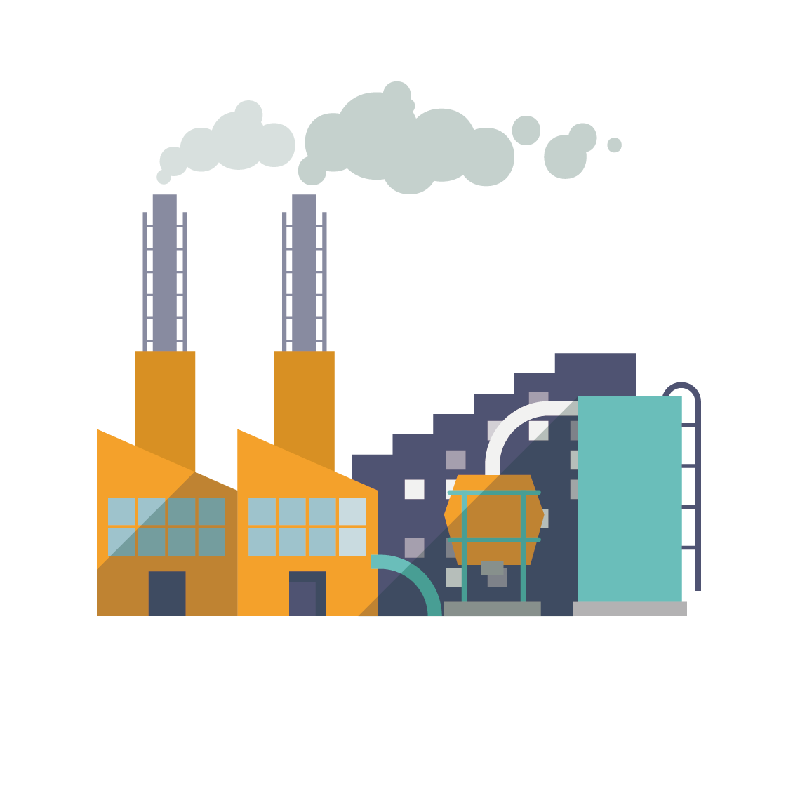
Pollution & Plastic bags
Gymnasium “Goce Delchev”- Kumanovo, North Macedonia

Slide 2
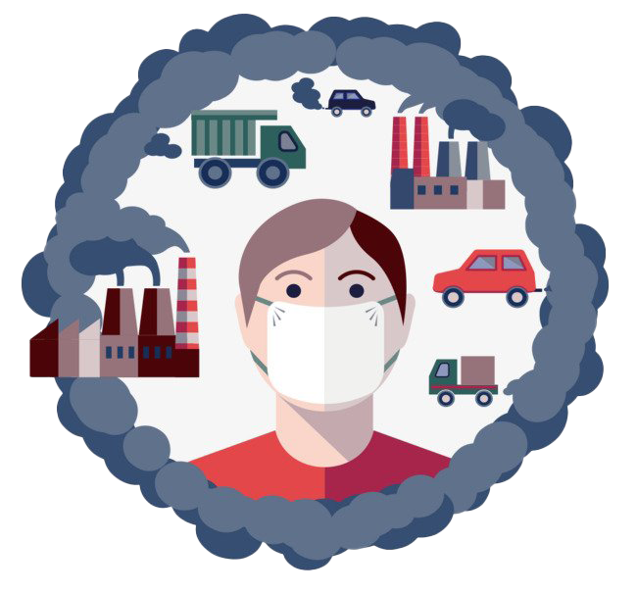
What is pollution?
Pollution is the introduction of harmful materials into the environment. These harmful materials are called pollutants.

Slide 3
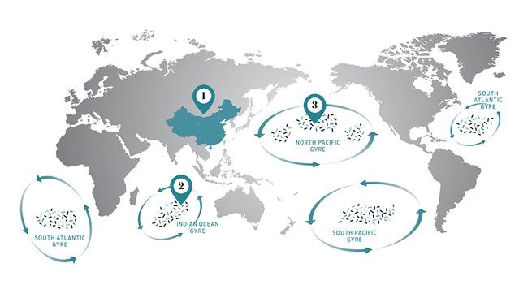
Pollution
If we consider global pollution, then it is a must to mention garbage patches that are present in oceans around the world.

Slide 4
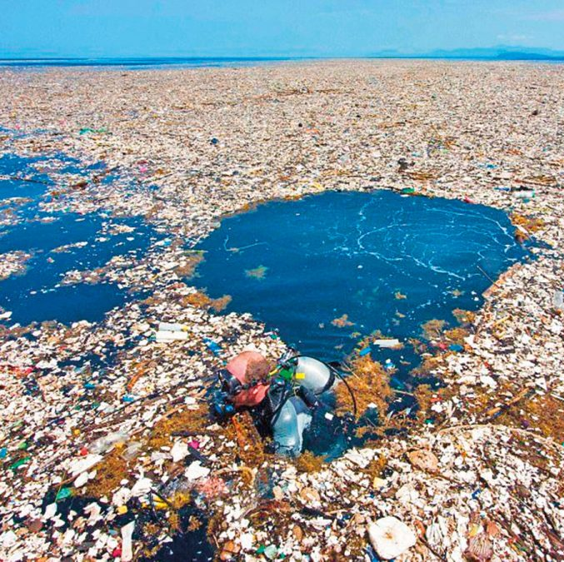
Pacific Garbage Patch
The most “famous” one is the Pacific Garbage Patch. It occupies an entire area of 20 mil. square km. or in ;simple terms it spreads from California to Japan. It is a hazard for marine life that easily mistakes the debris for food.

Slide 5
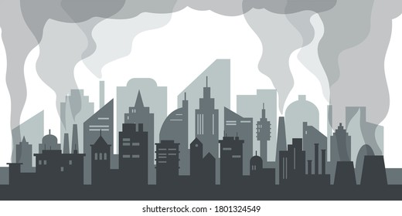
Air Pollution
Air pollution is a consequence of many factors, and in order to reduce it, it is necessary to reduce emissions of pollutants from all sources mentioned in the introduction.
The first step towards solving the pollution problem is determining the sources of pollution. For that purpose, the Ministry of Environment and Physical Planning, the City of Skopje and other relevant institutions in the past years have made a series of analysis and studies to determine in which period of the year the highest concentrations of pollutants occur.
Skopje, Europe's most polluted capital

Slide 6
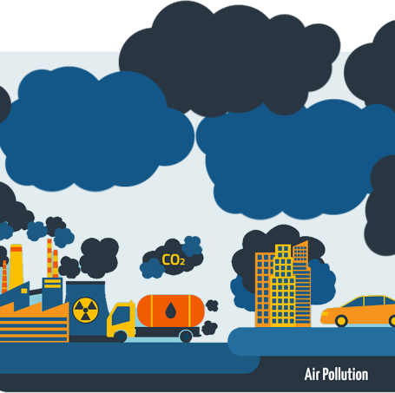
Air pollution
Air pollution has been a major problem in our country. Authorities have been trying to promote measures to decrease air pollution such as use of eco busses, cycling instead of using cars, sharing means of transport etc. However these measures have led to almost no result. In other words the problem is still present.

Slide 7
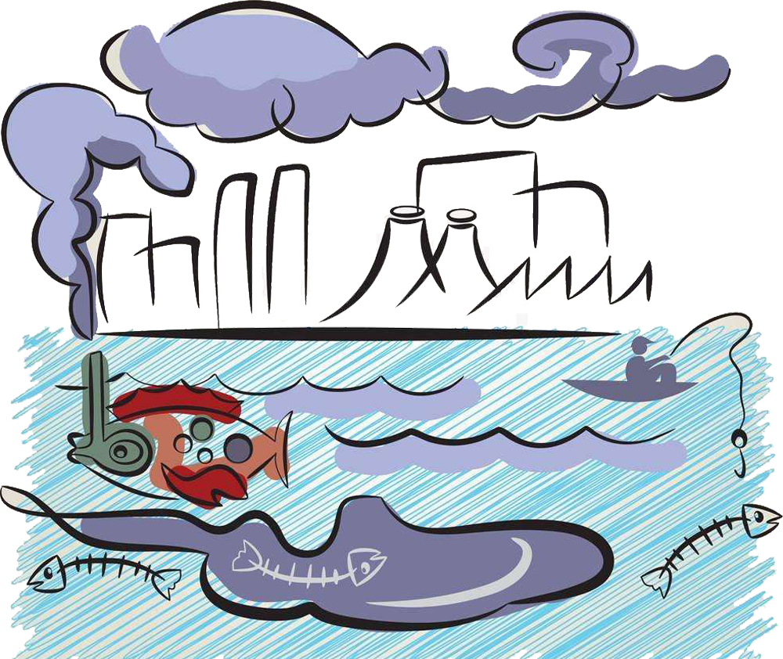
Water Pollution
The main sources of pollution of waters in the Republic of North Macedonia are: industrial and mining wastewaters, wastewaters from households and agriculture. The pollution is especially serious in the urban settlements with a greater number of inhabitants and with developed industry.

Slide 8
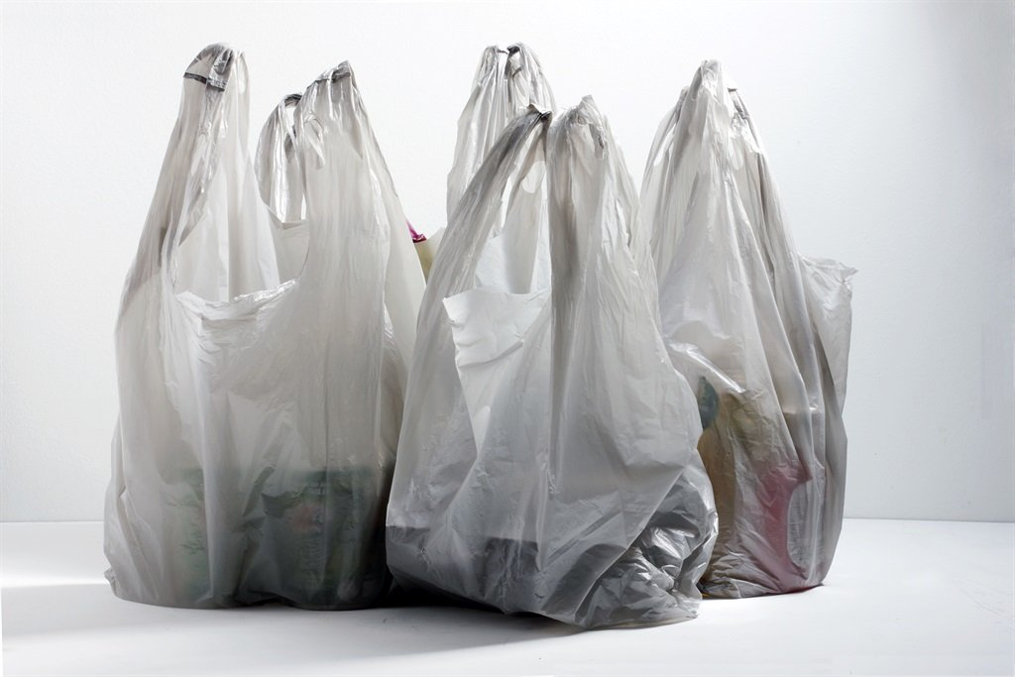
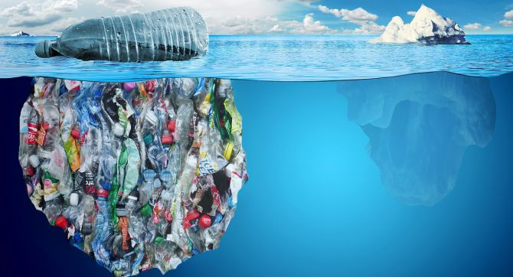
Plastic Bags
These factors can be caused by many reasons. One of the main contributors to the air and water pollution are plastic bags.

Slide 9
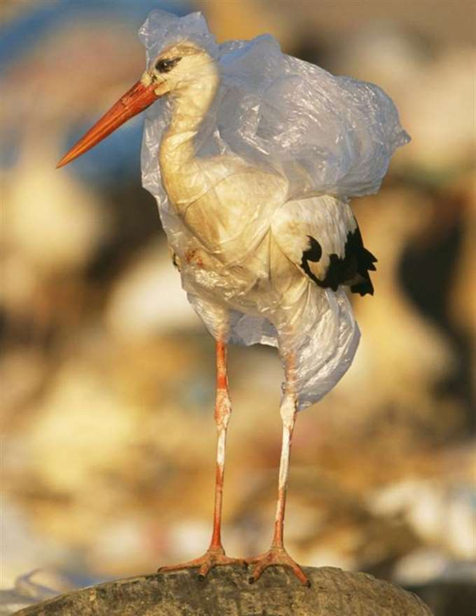
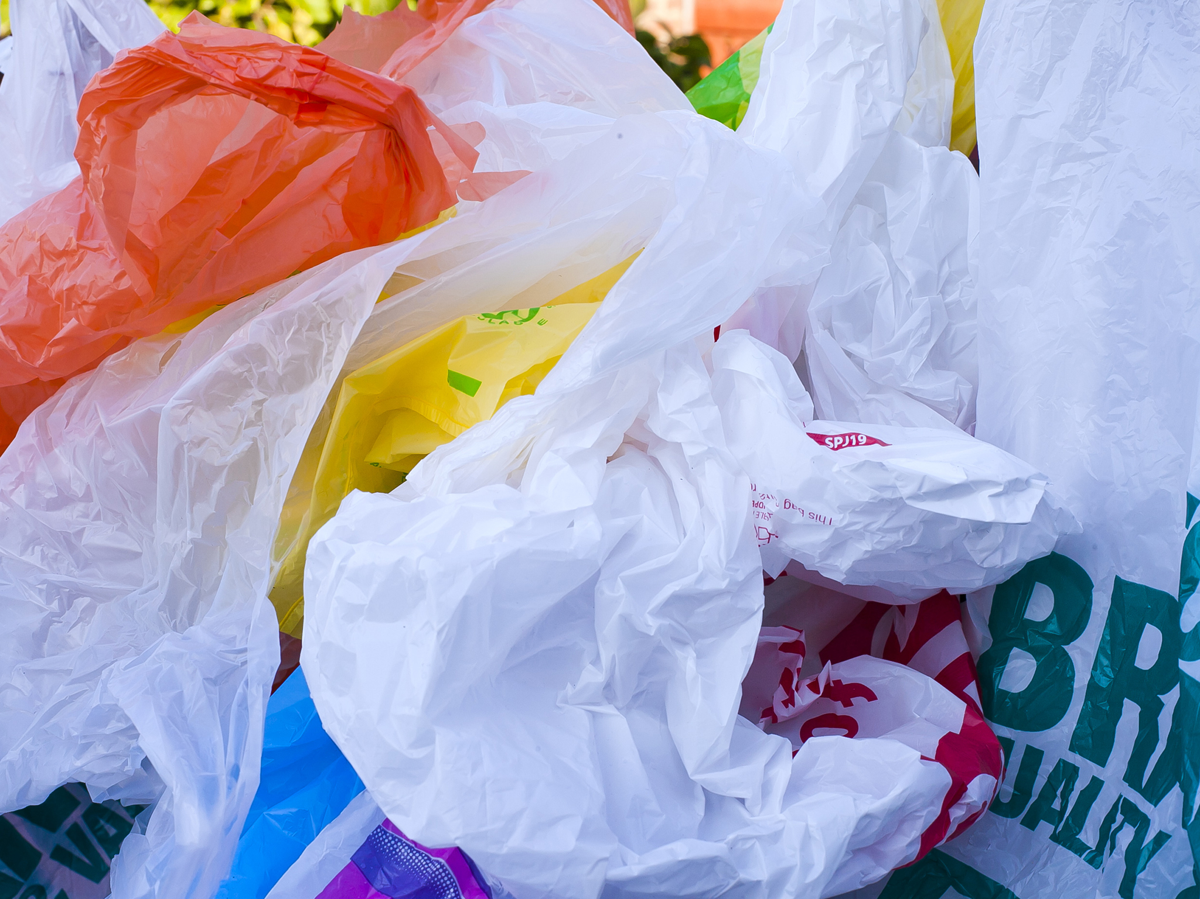
Plastic bags - pollution
While plastic bags are very useful in our day-to-day lives, and we seemingly can’t do without them, they have a significant contribution to the environmental pollution, wildlife deaths, human health hazards, and other detrimental impacts.

Slide 10
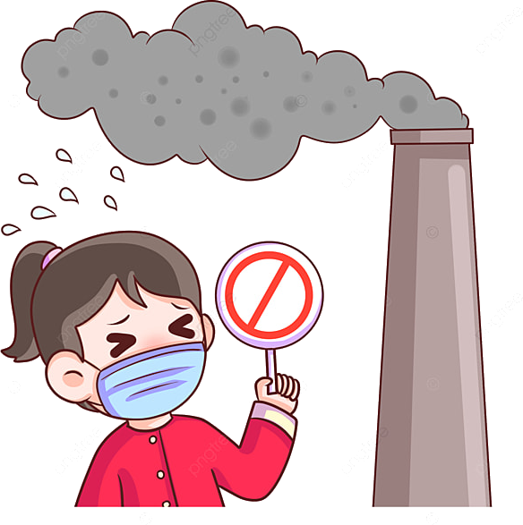
Plastic bags pollution – causes lung complications in children
Because of the chemical compounds found in plastic, mothers may give birth to children with lung problems. These children may also be at high risk of developing asthma later in life.
This problem contributes heavily in the outbreak of childhood obesity and diabetes. It has also been linked to kidney and heart complications.

Slide 11
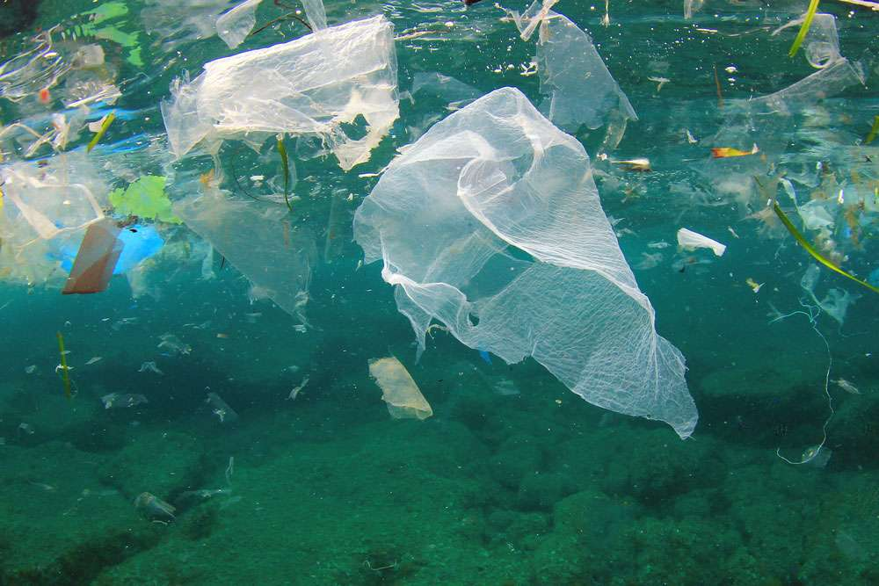
Plastic bags cause pollution of groundwater
The plastic bags in the dumpsite will normally release chemicals that seep into the ground, ending into the groundwater reservoirs. Then, the detrimental effects of plastics would be passed through the ground to our bodies through the plants we consume and the water we drink.

Slide 12
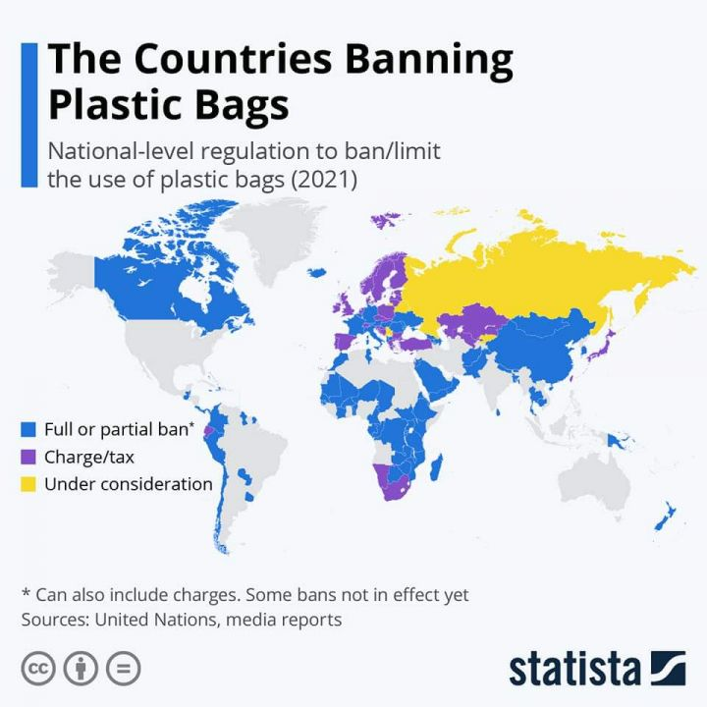
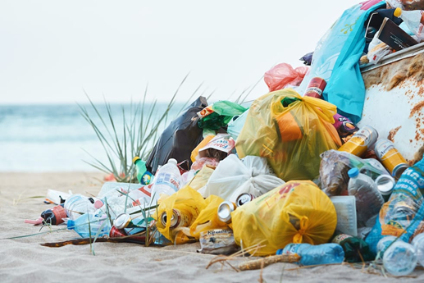
Plastic bags pollution in Macedonia
As of recently (1st December 2021) the Macedonian Government has decided to ban production and use of plastic bags in the Republic of North Macedonia. This has been a change in the way we use plastic bags. Plastic bags now cost 8 times the price than what they used to.

Slide 13
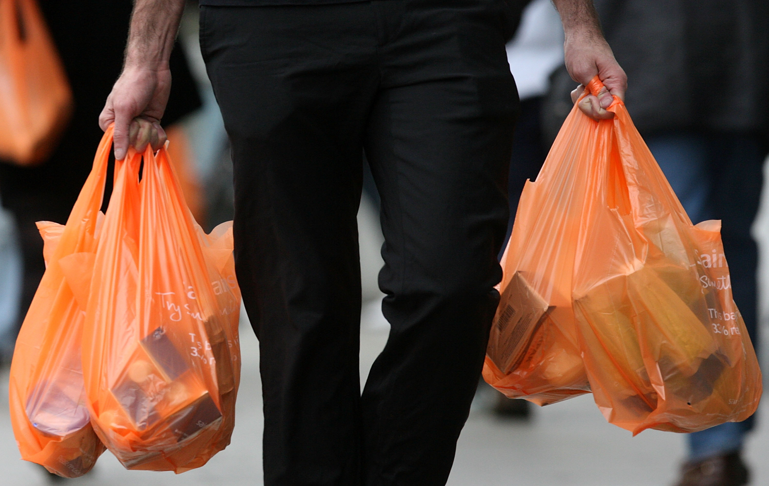
Why you should replace your plastic bags with bags made of fabric
The ban of plastic bags in Macedonia means that we’ll have a relatively lower number of plastic bags pollution here. It’s still a problem, though.
Many people still utilize plastic bags. However, many people also change their plastic bags for paper bags, or bags made of fabric instead. This is due to the higher price of the plastic bags.

Slide 14
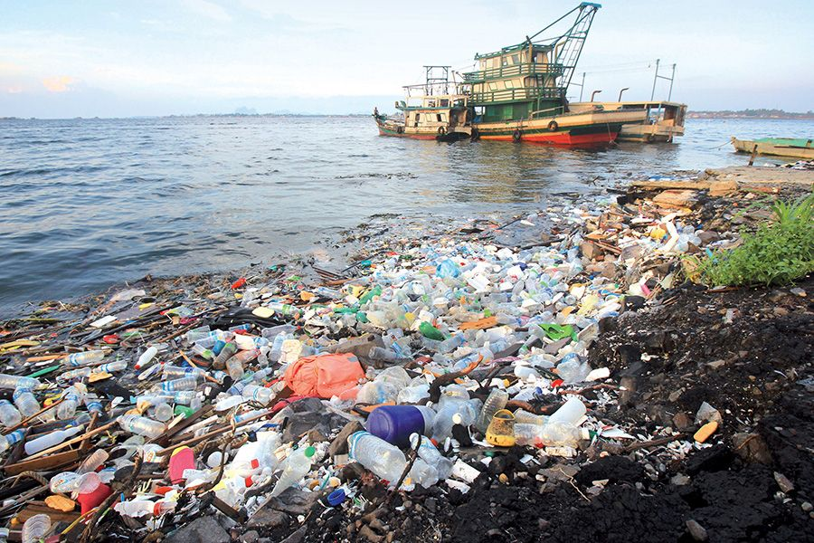
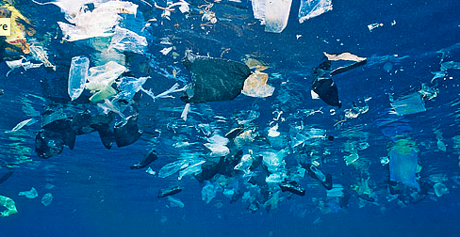
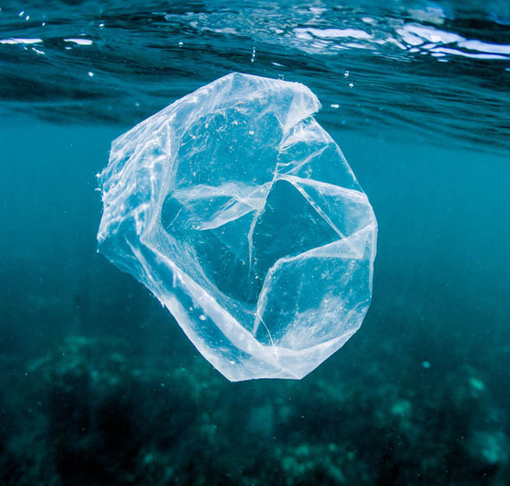
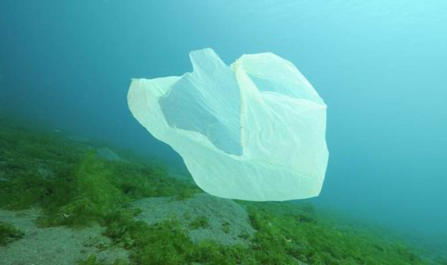
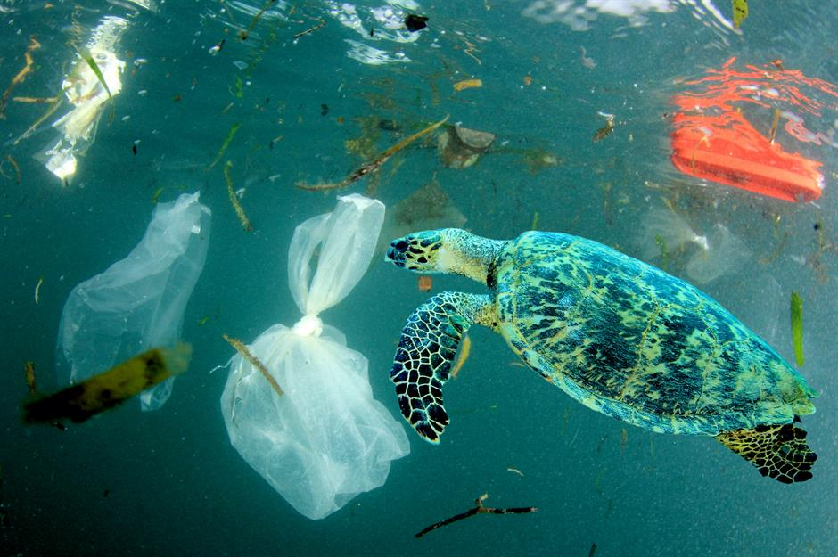
Thank you for your attention!

